Slide 1
Processes

Slide 2
Process Concept
An operating system executes a variety of programs:
  Batch system – jobs
  Time-shared systems – user programs or tasks
Process – a program in execution; process execution must progress in sequential fashion
Multiple parts
  The program code, also called text section
  Current activity including program counter, processor registers
  Stack containing temporary data
    Function parameters, return addresses, local variables
  Data section containing global variables
  Heap containing memory dynamically allocated during run time

Slide 3
Process Concept (Cont.)
Program is passive entity stored on disk (executable file), process is active
  Program becomes process when executable file loaded into memory
Execution of program started via GUI mouse clicks, command line entry of its name, etc

Slide 4

Process in Memory

Slide 5
Process State
As a process executes, it changes state
  new: The process is being created
  running: Instructions are being executed
  waiting: The process is waiting for some event to occur
  ready: The process is waiting to be assigned to a processor
  terminated: The process has finished execution

Slide 6

Diagram of Process State

Slide 7

Process Control Block (PCB)
Information associated with each process
(also called task control block)
Process state – running, waiting, etc
Program counter – location of instruction to next execute
CPU registers – contents of all process-centric registers
CPU scheduling information- priorities, scheduling queue pointers
Memory-management information – memory allocated to the process
Accounting information – CPU used,
I/O status information – I/O devices allocated to process, list of open files

Slide 8

Process Representation in Linux
Represented by the C structure task_struct
pid t_pid; /* process identifier */
long state; /* state of the process */
unsigned int time_slice /* scheduling information */
struct task_struct *parent; /* this process’s parent */
struct list_head children; /* this process’s children */
struct files_struct *files; /* list of open files */
struct mm_struct *mm; /* address space of this process */

Slide 9
Process Scheduling
Maximize CPU use, quickly switch processes onto CPU for time sharing
Process scheduler selects among available processes for next execution on CPU
Maintains scheduling queues of processes
  Job queue – set of all processes in the system
  Ready queue – set of all processes residing in main memory, ready and waiting to execute
  Device queues – set of processes waiting for an I/O device
  Processes migrate among the various queues

Slide 10

Representation of Process Scheduling
Queueing diagram represents queues, resources, flows

Slide 11
Schedulers
Short-term scheduler (or CPU scheduler) – selects which process should be executed next and allocates CPU
  Short-term scheduler is invoked frequently (milliseconds) ⇒ (must be fast)
Long-term scheduler (or job scheduler) – selects which processes should be brought into the ready queue
  Long-term scheduler is invoked infrequently (seconds, minutes) ⇒ (may be slow)
  The long-term scheduler controls the degree of multiprogramming
Processes can be described as either:
  I/O-bound process – spends more time doing I/O than computations, many short CPU bursts
  CPU-bound process – spends more time doing computations; few very long CPU bursts
Long-term scheduler strives for good process mix

Slide 12

Addition of Medium Term Scheduling
Medium-term scheduler can be added if degree of multiple programming needs to decrease
  Remove process from memory, store on disk, bring back in from disk to continue execution: swapping

Slide 13

CPU Switch From Process to Process

Slide 14
Context Switch
When CPU switches to another process, the system must save the state of the old process and load the saved state for the new process via a context switch
Context of a process represented in the PCB
Context-switch time is overhead; the system does no useful work while switching
  The more complex the OS and the PCB ➔ the longer the context switch

Slide 15
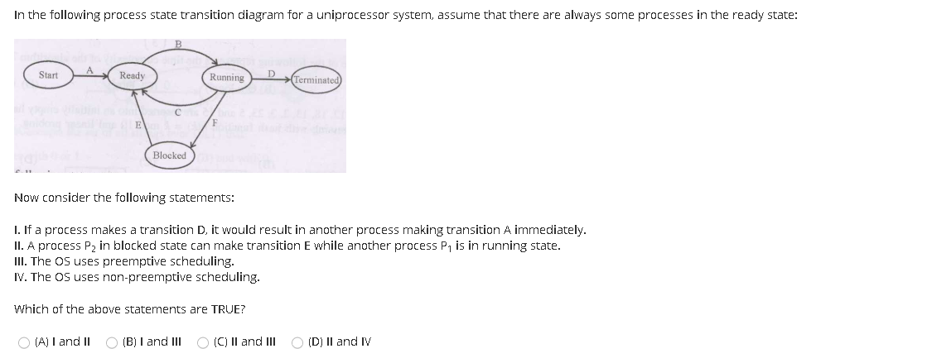

Slide 16
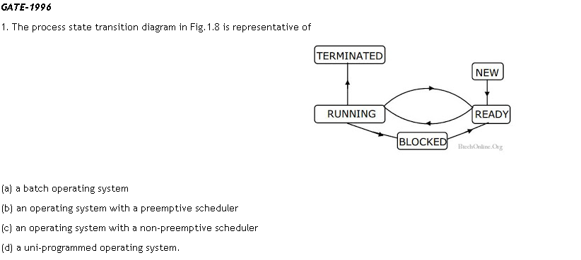

Slide 17
Operations on Processes
System must provide mechanisms for:
  process creation,
  process termination,

Slide 18
Process Creation
Parent process create children processes, which, in turn create other processes, forming a tree of processes
Generally, process identified and managed via a process identifier (pid)
Resource sharing options
  Parent and children share all resources
  Children share subset of parent’s resources
  Parent and child share no resources
Execution options
  Parent and children execute concurrently
  Parent waits until children terminate

Slide 19

A Tree of Processes in Linux

Slide 20

Process Creation (Cont.)
Address space
  Child duplicate of parent
  Child has a program loaded into it
UNIX examples
  fork() system call creates new process
  exec() system call used after a fork() to replace the process’ memory space with a new program

Slide 21
fork()
Fork system call is used for creating a new process, which is called child process, which runs concurrently with the process that makes the fork() call (parent process).
After a new child process is created, both processes will execute the next instruction following the fork() system call.
It takes no parameters and returns an integer value.
Here the parent and Child have Separate Address space
Below are different values returned by fork().
Negative Value: creation of a child process was unsuccessful.
Zero: Returned to the newly created child process.
Positive value: Returned to parent or caller. The value contains process ID of newly created child process.

Slide 22
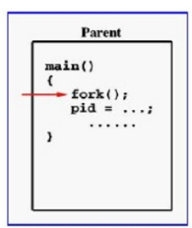
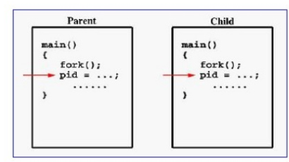

Slide 23
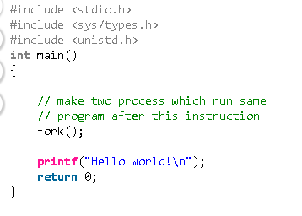
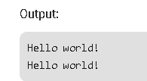

Slide 24
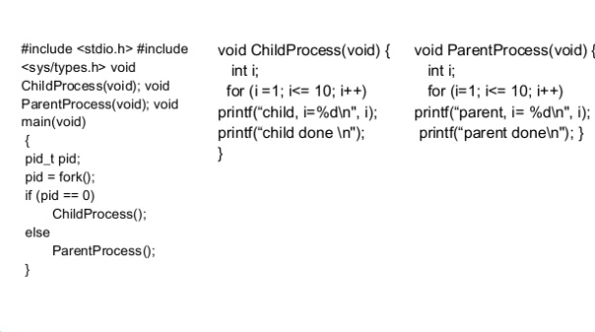

Slide 25
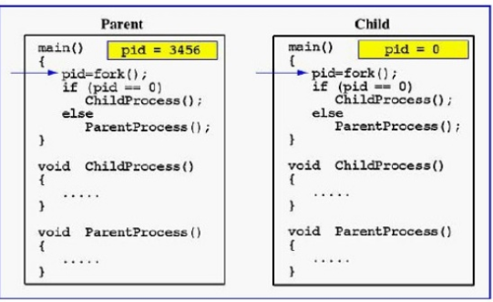
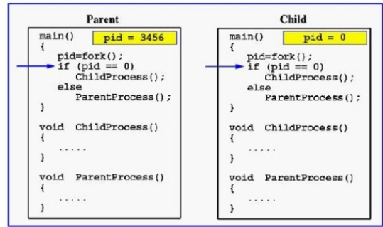

Slide 26
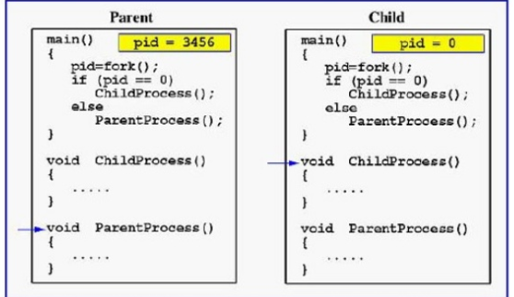

Slide 27
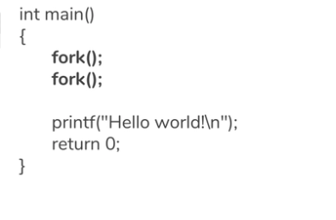
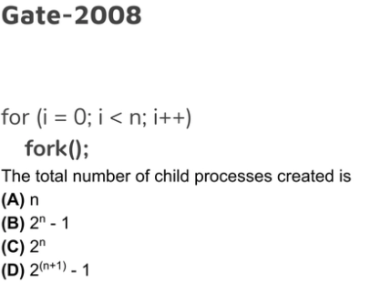
Ans:B

Slide 28

C Program Forking Separate Process

Slide 29
Process Termination
Process executes last statement and then asks the operating system to delete it using the exit() system call.
  Returns status data from child to parent (via wait())
  Process’ resources are deallocated by operating system
Parent may terminate the execution of children processes using the abort() system call. Some reasons for doing so:
  Child has exceeded allocated resources
  Task assigned to child is no longer required
  The parent is exiting and the operating systems does not allow a child to continue if its parent terminates

Slide 30
Process Termination
Some operating systems do not allow child to exists if its parent has terminated. If a process terminates, then all its children must also be terminated.
  cascading termination. All children, grandchildren, etc. are terminated.
  The termination is initiated by the operating system.
The parent process may wait for termination of a child process by using the wait()system call. The call returns status information and the pid of the terminated process
pid = wait(&status);
If no parent waiting (did not invoke wait()) process is a zombie
If parent terminated without invoking wait , process is an orphan

Slide 31
orphan process is a computer process whose parent process has finished or terminated, though it (child process) remains running itself.
A zombie process or defunct process is a process that has completed execution but still has an entry in the process table as its parent process didn't invoke an wait() system call.

